Slide 1
ECE 8803 Term Project: Comparison between Four Classification Methods for DRSS Severity Classification on OCT images
By Tawhid Khan, Syed Anas Hussain

Slide 2
Introduction
Used 4 image classification methods on OCT image dataset to perform Diabetic Retinopathy Severity Scale (DRSS) severity classification.
Classification methods:
KNN
Logistic Regression
CNN
Random Forest
Performance analysis using:
Accuracy
Balanced Accuracy
Precision
Recall
F1 Score
True Positive Rate
False Positive Rate

Slide 3

KNN Methodology
Utilized scikit-learn KNN classifier with varying number of neighbors.
Trained on greyscale OCT images (224x224 pixels).
Used Euclidean distance metric.

Slide 4
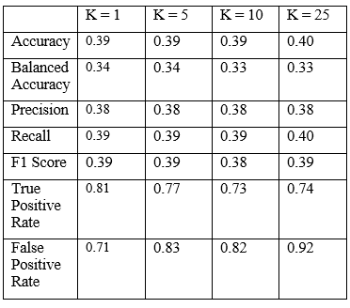
KNN Results
Accuracy, Balanced Accuracy, Precision,
Recall, and F1 score did not vary greatly.
TPR decreased as K increased.
FPR increased as K increased.
Imbalance dataset: higher bias to
majority class led to lower true
positive rate for minority classes
and decreased overall true positive rate.

Slide 5
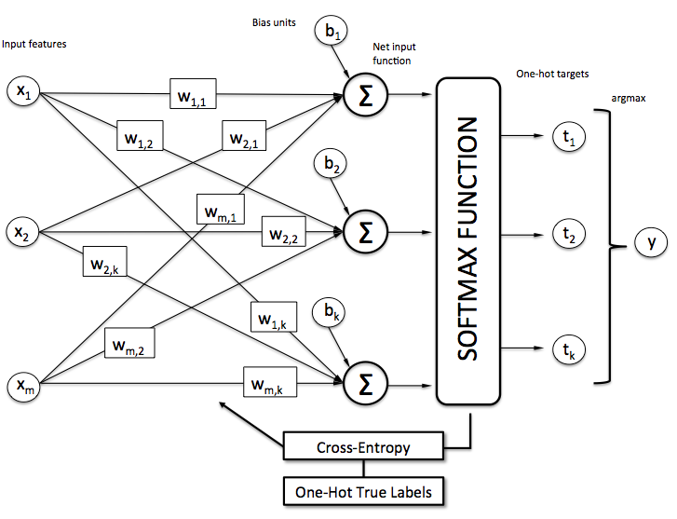
Logistic Regression Methodology
Scikit-learn’s logistic regression model used.
Stochastic Average Gradient (SAG) solver for fast convergence on large dataset.
Softmax activation for multiclass classification.
1000 maximum iterations.

Slide 6
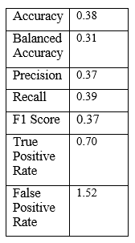
Logistic Regression Results
Lower accuracy and balanced accuracy
than all KNN models.
Lower TPR and higher FPR than all KNN
Models.
logistic regression assumes a linear
relationship between features and
Labels while the data might not be.

Slide 7
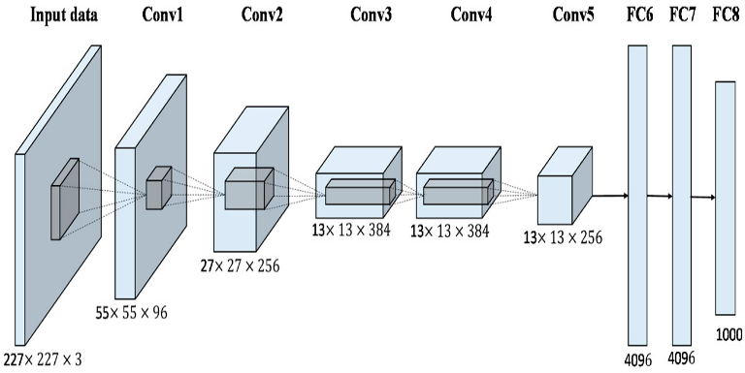
CNN Methodology
Utilized the pre-defined AlexNet architecture from torchvision
Modified the first and last layers of the CNN to account for the size of the input images and the number of class labels
Ran the training algorithm on 64x64 resized images for faster performance
Utilized a batch size of 100 and learning rate of 0.0001. Ran training for 20 epochs.

Slide 8
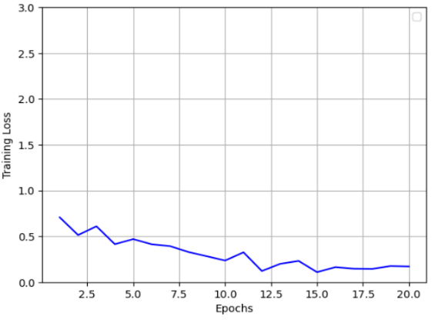
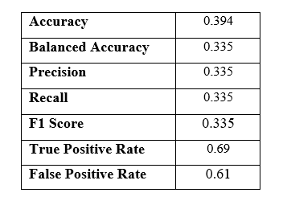
CNN Results
Accuracy similar to KNN & Logistic Regression. Balanced Accuracy is similar to KNN.
Other metrics except for FPR lower than KNN and Logistic Regression.
Imbalanced data could have resulted in better performance on the majority class but not so well on the minority class.
Further improved by transfer learning, data augmentation techniques, and hyperparameter tuning.

Slide 9
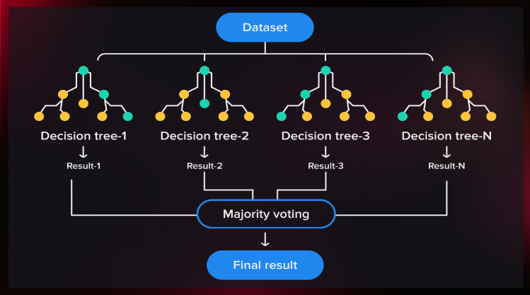
Random Forest Methodology
Ensemble learning algorithm that can be used for classification and regression.
Works by constructing multiple decision trees, each with a random subset of features and a random subset of training instances.
Each decision tree is trained independently and makes a classification decision. Final decision is based on the majority vote of all the trees in the forest.
Trained using sklearn’s Random Forest model with a batch size of 64 and number of estimators (decision trees) equal to 100.

Slide 10
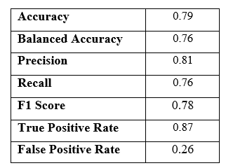
Random Forest Results
Performed the best in all metrics with high accuracy, balanced accuracy, and precision.
Had a high true positive rate and low false positive rate.
Radom Forest works well even on imbalanced datasets.
Random Forest can capture non-linear relationships between features and the target variable. The ensemble learning approach combines these decision trees to make a final prediction.

Slide 11
Thank you!

